Slide 1


Sequence Models
Cheng‐Te Li (李政德)
Institute of Data Science
National Cheng Kung University
chengte@mail.ncku.edu.tw

Slide 2
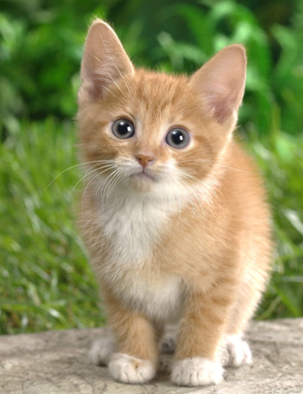
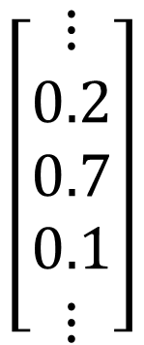

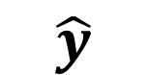
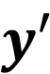
Image Classification
$$\left[\begin{aligned}⋮ \\ 0.2 \\ 0.7 \\ 0.1 \\ ⋮\end{aligned}\right]$$
$$\left[\begin{aligned}⋮ \\ 0 \\ 1 \\ 0 \\ ⋮\end{aligned}\right]$$
dog
cat
tree
Model
$$y′$$
$$\hat{y}$$
Cross
entropy
100 x 100
(All the images to be classified have the same size.)
Notes:
You cannot add new classed

Slide 3
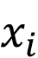
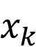
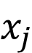
Fully Connected Network
100 x 100
$$x_{i}$$
……
……
3 x 10⁷
……
$$x_{j}$$
100 x 100
……
$$x_{k}$$
……
100 x 100 x 3
1000
100 x 100
Do we really need “fully connected” in image processing?
Notes:
More parameters,
Not only computational intensive
But also easier to overfit

Slide 4


Motivation
A neuron does not have to see the whole image.
Identifying some critical patterns
Need to see the whole image?
Input
Layer 1
Layer 2
……
Bird?
……
……
……
……
……
basic
detector
advanced
detector
Some patterns are much smaller than the whole image.
Notes:
https://www.dcard.tw/f/funny/p/233833012

Slide 5
Can different neurons have different sizes of receptive field?
Receptive field
Cover only some channels?
Not square receptive field?
3 x 3 x 3 weights
the same receptive field
Receptive field
1 | 0 | 0 | 0 | 0 | 1
0 | 1 | 0 | 0 | 1 | 0
0 | 0 | 1 | 1 | 0 | 0
1 | 0 | 0 | 0 | 1 | 0
0 | 1 | 0 | 0 | 1 | 0
0 | 0 | 1 | 0 | 1 | 0
1 | 0 | 0 | 0 | 0 | 1
0 | 1 | 0 | 0 | 1 | 0
0 | 0 | 1 | 1 | 0 | 0
1 | 0 | 0 | 0 | 1 | 0
0 | 1 | 0 | 0 | 1 | 0
0 | 0 | 1 | 0 | 1 | 0
1 | 0 | 0 | 0 | 0 | 1
0 | 1 | 0 | 0 | 1 | 0
0 | 0 | 1 | 1 | 0 | 0
1 | 0 | 0 | 0 | 1 | 0
0 | 1 | 0 | 0 | 1 | 0
0 | 0 | 1 | 0 | 1 | 0
Can be overlapped

Slide 6
Filter typical setting
Each receptive field has a set of neurons (e.g., 64 neurons).
stride = 2
overlap
all channels
1 | 0 | 0 | 0 | 0 | 1
0 | 1 | 0 | 0 | 1 | 0
0 | 0 | 1 | 1 | 0 | 0
1 | 0 | 0 | 0 | 1 | 0
0 | 1 | 0 | 0 | 1 | 0
0 | 0 | 1 | 0 | 1 | 0
1 | 0 | 0 | 0 | 0 | 1
0 | 1 | 0 | 0 | 1 | 0
0 | 0 | 1 | 1 | 0 | 0
1 | 0 | 0 | 0 | 1 | 0
0 | 1 | 0 | 0 | 1 | 0
0 | 0 | 1 | 0 | 1 | 0
kernel size (e.g., 3 x 3)
1 | 0 | 0 | 0 | 0 | 1
0 | 1 | 0 | 0 | 1 | 0
0 | 0 | 1 | 1 | 0 | 0
1 | 0 | 0 | 0 | 1 | 0
0 | 1 | 0 | 0 | 1 | 0
0 | 0 | 1 | 0 | 1 | 0
padding
The receptive fields cover the whole image.
Notes:
守的滴水不漏無懈可擊

Slide 7


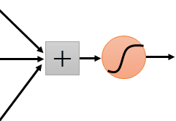
Motivation
The same patterns appear in different regions.
I detect “beak” in my receptive field.
Each receptive field needs a “beak” detector?
I detect “beak” in my receptive field.

Slide 8
Sliding window
3 x 3 x 3 weights
…...
bias
1 | 0 | 0 | 0 | 0 | 1
0 | 1 | 0 | 0 | 1 | 0
0 | 0 | 1 | 1 | 0 | 0
1 | 0 | 0 | 0 | 1 | 0
0 | 1 | 0 | 0 | 1 | 0
0 | 0 | 1 | 0 | 1 | 0
1
1 | 0 | 0 | 0 | 0 | 1
0 | 1 | 0 | 0 | 1 | 0
0 | 0 | 1 | 1 | 0 | 0
1 | 0 | 0 | 0 | 1 | 0
0 | 1 | 0 | 0 | 1 | 0
0 | 0 | 1 | 0 | 1 | 0
1 | 0 | 0 | 0 | 0 | 1
0 | 1 | 0 | 0 | 1 | 0
0 | 0 | 1 | 1 | 0 | 0
1 | 0 | 0 | 0 | 1 | 0
0 | 1 | 0 | 0 | 1 | 0
0 | 0 | 1 | 0 | 1 | 0
…
parameter sharing
3 x 3 x 3 weights
…...
bias
1
…

Slide 9
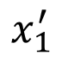

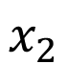
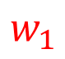
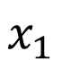
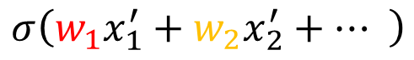
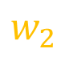
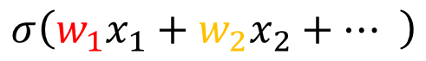
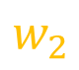
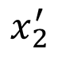
$$x_{1}$$
$$σ\left(w_{1}x_{1}+w_{2}x_{2}+… \right)$$
Convolution layer
$$x_{2}$$
$$w_{1}$$
Side based on neural
…...
$$w_{2}$$
bias
1 | 0 | 0 | 0 | 0 | 1
0 | 1 | 0 | 0 | 1 | 0
0 | 0 | 1 | 1 | 0 | 0
1 | 0 | 0 | 0 | 1 | 0
0 | 1 | 0 | 0 | 1 | 0
0 | 0 | 1 | 0 | 1 | 0
1
1 | 0 | 0 | 0 | 0 | 1
0 | 1 | 0 | 0 | 1 | 0
0 | 0 | 1 | 1 | 0 | 0
1 | 0 | 0 | 0 | 1 | 0
0 | 1 | 0 | 0 | 1 | 0
0 | 0 | 1 | 0 | 1 | 0
1 | 0 | 0 | 0 | 0 | 1
0 | 1 | 0 | 0 | 1 | 0
0 | 0 | 1 | 1 | 0 | 0
1 | 0 | 0 | 0 | 1 | 0
0 | 1 | 0 | 0 | 1 | 0
0 | 0 | 1 | 0 | 1 | 0
…
$$x_{1}^{′}$$
$$σ\left(w_{1}x_{1}^{′}+w_{2}x_{2}^{′}+… \right)$$
$$x_{2}^{′}$$
$$w_{1}$$
…...
$$w_{2}$$
bias
Two neurons with the same receptive field would not share parameters.
1
…

Slide 10
Convolution layer
Each receptive field has a set of neurons (e.g., 64 neurons).
Each receptive field has the neurons with the same set of parameters.
filter 1
1 | 0 | 0 | 0 | 0 | 1
0 | 1 | 0 | 0 | 1 | 0
0 | 0 | 1 | 1 | 0 | 0
1 | 0 | 0 | 0 | 1 | 0
0 | 1 | 0 | 0 | 1 | 0
0 | 0 | 1 | 0 | 1 | 0
filter 1
1 | 0 | 0 | 0 | 0 | 1
0 | 1 | 0 | 0 | 1 | 0
0 | 0 | 1 | 1 | 0 | 0
1 | 0 | 0 | 0 | 1 | 0
0 | 1 | 0 | 0 | 1 | 0
0 | 0 | 1 | 0 | 1 | 0
1 | 0 | 0 | 0 | 0 | 1
0 | 1 | 0 | 0 | 1 | 0
0 | 0 | 1 | 1 | 0 | 0
1 | 0 | 0 | 0 | 1 | 0
0 | 1 | 0 | 0 | 1 | 0
0 | 0 | 1 | 0 | 1 | 0
filter 2
filter 2
filter 3
filter 3
filter 4
filter 4
……
……

Slide 11
Benefit of Convolutional Layer
Fully Connected Layer
Jack of all trades,
master of none
Receptive Field
Parameter Sharing
Convolutional Layer
Larger model bias
(for image)
Some patterns are much smaller than the whole image.
The same patterns appear in different regions.
Notes:
Need an metaphor?

Slide 12

Another story based on filter
Convolution layer
Filter 1
3 x 3 x channel
tensor
Convolution
Filter 2
3 x 3 x channel
tensor
……
……
channel = 3
(colorful)
Each filter detects a small pattern (3 x 3 x channel).
channel = 1
(black and white)
Notes:
64 filters

Slide 13
Convolution layer
Consider channel = 1
(black and white image)
1 | -1 | -1
-1 | 1 | -1
-1 | -1 | 1
1 | 0 | 0 | 0 | 0 | 1
0 | 1 | 0 | 0 | 1 | 0
0 | 0 | 1 | 1 | 0 | 0
1 | 0 | 0 | 0 | 1 | 0
0 | 1 | 0 | 0 | 1 | 0
0 | 0 | 1 | 0 | 1 | 0
Filter 1
-1 | 1 | -1
-1 | 1 | -1
-1 | 1 | -1
Filter 2
……
6 x 6 image
(The values in the filters are unknown parameters.)

Slide 14
Convolution layer
1 | -1 | -1
-1 | 1 | -1
-1 | -1 | 1
Filter 1
stride=1
1 | 0 | 0 | 0 | 0 | 1
0 | 1 | 0 | 0 | 1 | 0
0 | 0 | 1 | 1 | 0 | 0
1 | 0 | 0 | 0 | 1 | 0
0 | 1 | 0 | 0 | 1 | 0
0 | 0 | 1 | 0 | 1 | 0
3
-1
-3
-1
-3
1
0
-3
-3
-3
0
1
3
-2
-2
-1
6 x 6 image

Slide 15
-1 | 1 | -1
-1 | 1 | -1
-1 | 1 | -1
Convolution layer
Filter 2
stride=1
Do the same process for every filter
1 | 0 | 0 | 0 | 0 | 1
0 | 1 | 0 | 0 | 1 | 0
0 | 0 | 1 | 1 | 0 | 0
1 | 0 | 0 | 0 | 1 | 0
0 | 1 | 0 | 0 | 1 | 0
0 | 0 | 1 | 0 | 1 | 0
3
-1
-3
-1
-1
-1
-1
-1
-3
1
0
-3
-1
-1
-2
1
Feature
Map
-3
-3
0
1
-1
-1
-2
1
3
-2
-2
-1
6 x 6 image
-1
0
-4
3
Notes:
4 x 4 image

Slide 16
Multiple convolution layer
3
-1
-3
-1
-1
-1
-1
-1
-3
1
0
-3
-1
-1
-2
1
-3
-3
0
1
-1
-1
-2
1
3
-2
-2
-1
-1
0
-4
3
64 filters
Convolution
“Image” with 64 channels
Convolution
Filter:
3 x 3 x 64
……
64

Slide 17
Comparison of Two Stories
1 | -1 | -1
-1 | 1 | -1
-1 | -1 | 1
Filter
…...
3 x 3 x channel
tensor
Receptive field
(ignore bias in this slide)

Slide 18
Convolutional Layer
Neuron Version Story
Filter Version Story
Each neuron only considers a receptive field.
There are a set of filters detecting small patterns.
The neurons with different receptive fields share the parameters.
Each filter convolves over the input image.
They are the same story.
Notes:
No going to use this page ……
Each filter convolves over the input image.

Slide 19


Motivation
Subsampling the pixels will not change the object
bird
bird
subsampling
Notes:
We can subsample the pixels to make image smaller
Less parameters for the network to process the image

Slide 20
Pooling – Max Pooling
1 | -1 | -1
-1 | 1 | -1
-1 | -1 | 1
-1 | 1 | -1
-1 | 1 | -1
-1 | 1 | -1
Filter 1
Filter 2
3
-1
-3
-1
-1
-1
-1
-1
-3
1
0
-3
-1
-1
-2
1
-3
-3
0
1
-1
-1
-2
1
3
-2
-2
-1
-1
0
-4
3
Notes:
It does not have parameters
Like activation function, like relu, sigmoid

Slide 21
Convolutional Layers
+ Pooling
3
-1
-3
-1
-1
-1
-1
-1
-3
1
0
-3
-1
-1
-2
1
-3
-3
0
1
-1
-1
-2
1
3
-2
-2
-1
-1
0
-4
3
Convolution
“Image” with 64 channels
Repeat
Pooling
3
0
-1
1
3
1
0
3
……

Slide 22

The whole CNN
cat dog ……
Convolution
softmax
Pooling
Fully Connected Layers
Convolution
Pooling
Flatten

Slide 23
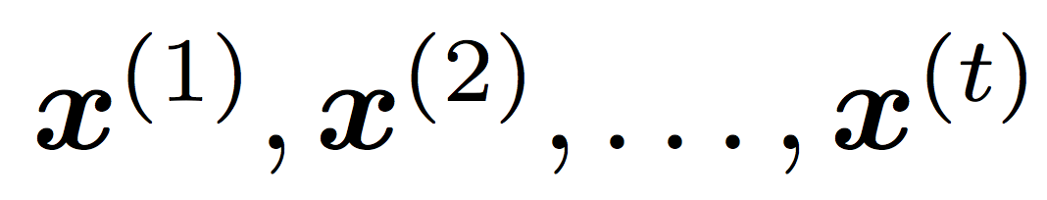
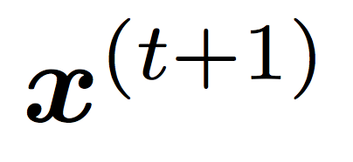
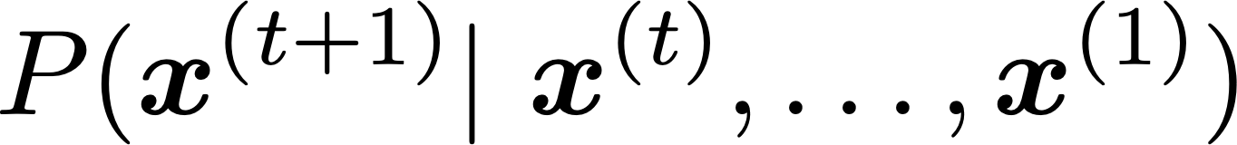
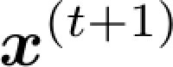
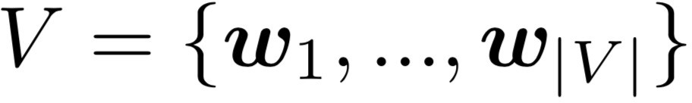
Language Modeling
Language Modeling is the task of predicting what word comes next
books
laptops
the students opened their
exams
minds
More formally: given a sequence of words
compute the probability distribution of the next word
,
:
where can be any word in the vocabulary
A system that does this is called a Language Model

Slide 24
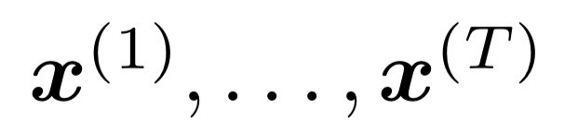
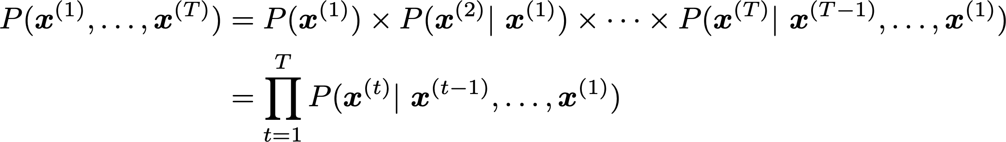
Language Modeling
You can also think of a Language Model as a system that assigns a probability to a piece of text
For example, if we have some text , then the probability of this text (according to the Language Model) is:
This is what our LM provides

Slide 25
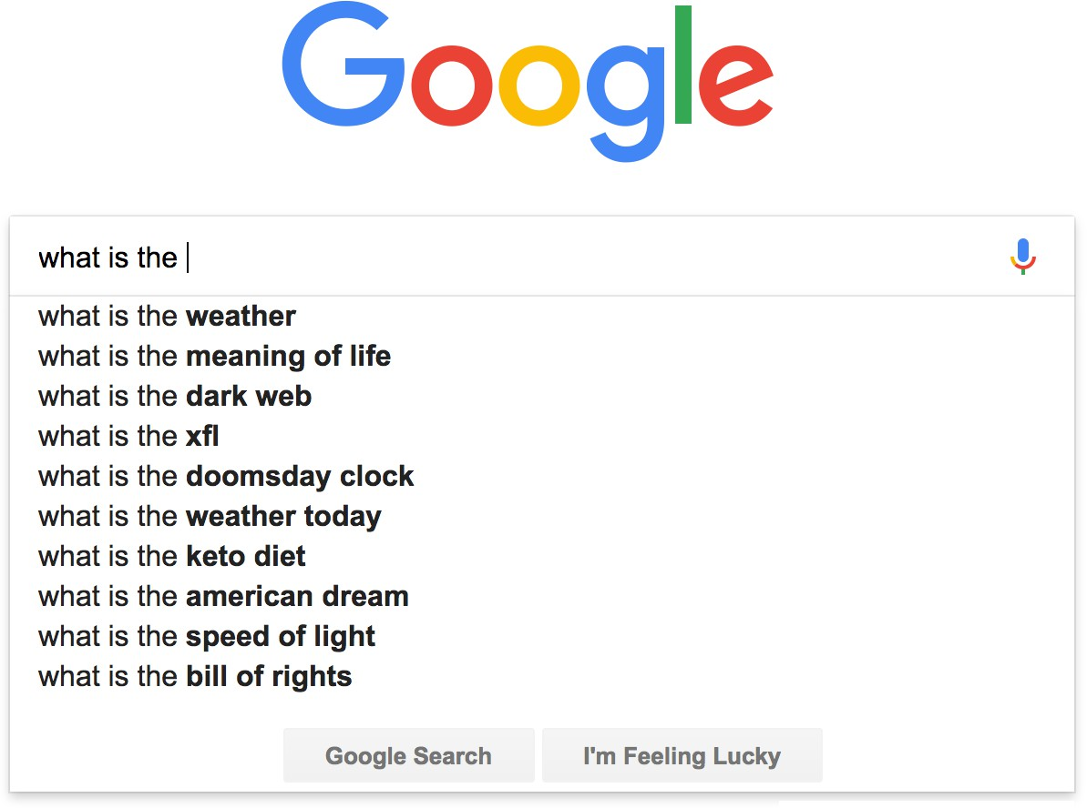

You use Language Models every day!

Slide 26
n-gram Language Models
the students opened their
Question: How to learn a Language Model?
Answer (pre- Deep Learning): learn an n-gram Language Model!
Definition: An n-gram is a chunk of n consecutive words.
unigrams: “the”, “students”, “opened”, ”their”
bigrams: “the students”, “students opened”, “opened their”
trigrams: “the students opened”, “students opened their”
four-grams: “the students opened their”
Idea: Collect statistics about how frequent different n-grams are and use these to predict next word.
Note: Increasing n makes sparsity problems worse.
Typically, we can’t have n bigger than 5.

Slide 27
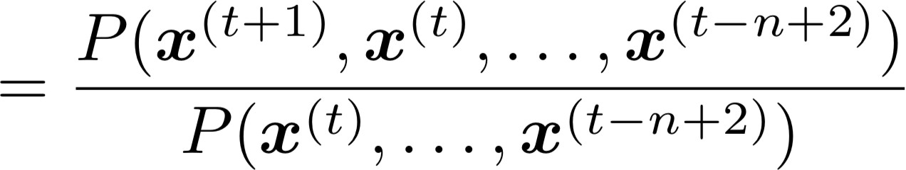
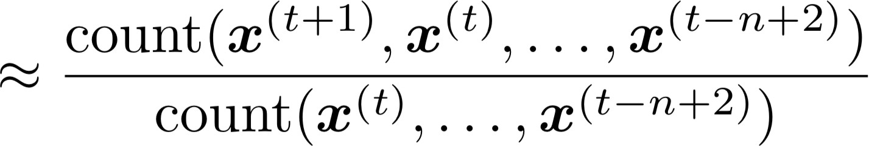
n-gram Language Models
First we make a Markov assumption: 𝑥^{(𝑡+1)} depends only on the preceding n-1 words
n-1 words
(assumption)
prob of a n-gram
(definition of conditional prob)
prob of a (n-1)-gram
Question: How do we get these n-gram and (n-1)-gram probabilities?
Answer: By counting them in some large corpus of text!
(statistical approximation)

Slide 28
Generating text with a n-gram Language Model
You can also use a Language Model to generate text
today the price of gold per ton , while production of shoe lasts and shoe industry , the bank intervened just after it considered and rejected an imf demand to rebuild depleted european stocks , sept 30 end primary 76 cts a share .
Surprisingly grammatical!
…but incoherent. We need to consider more than three words at a time if we want to model language well.

Slide 29
A fixed-window neural Language Model
How about a window-based neural model?
as
the
proctor started the
clock
the students opened
fixed window
their
discard

Slide 30

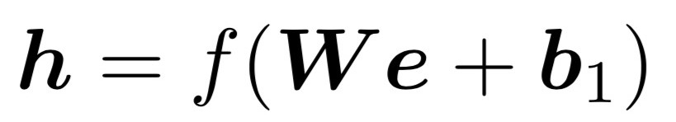





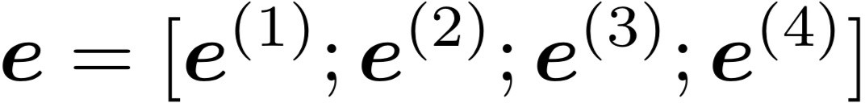





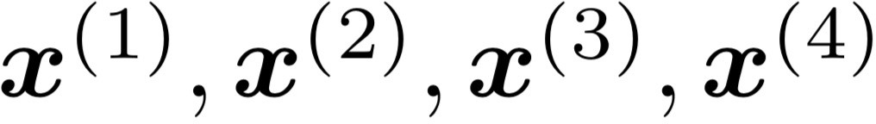
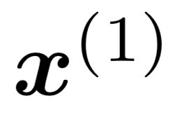
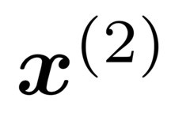
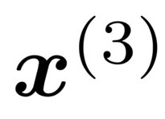
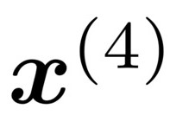
A fixed-window neural Language Model
books
laptops
output distribution
a
zoo
hidden layer
concatenated word embeddings
words / one-hot vectors
the students
opened
their

Slide 31




A fixed-window neural Language Model
Improvements over n-gram LM:
No sparsity problem
Don’t need to store all observed n-grams
books
laptops
Remaining problems:
Fixed window is too small
Enlarging window enlarges 𝑊
Window can never be large enough!
𝑥⁽¹⁾ and 𝑥⁽²⁾ are multiplied by completely different weights in 𝑊. No symmetry in how the inputs are processed.
a
zoo
We need a neural architecture that can process any length input
the students
opened
their

Slide 32
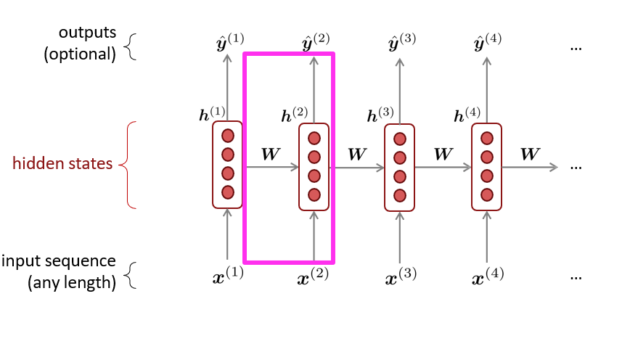
Recurrent Neural Networks (RNN)
A family of neural architectures
Core idea: Apply the same weights 𝑊 repeatedly

Slide 33
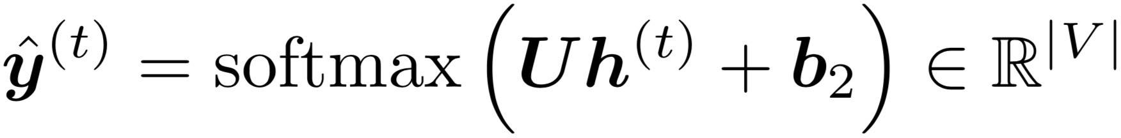

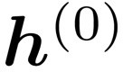
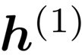
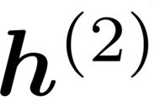
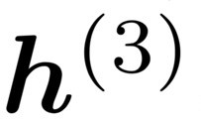
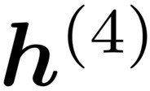

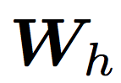


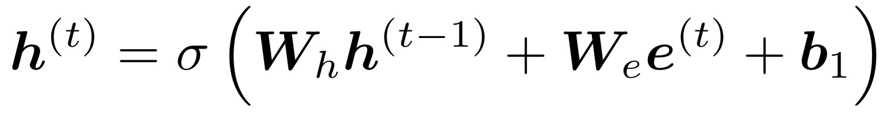






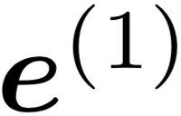
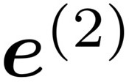
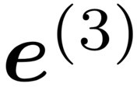
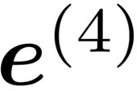
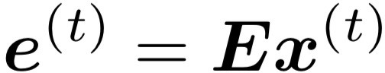

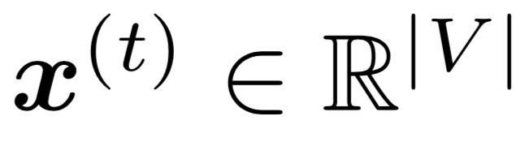
A Simple RNN Language Model
books
laptops
output distribution
a
zoo
hidden states
is the initial hidden state
word embeddings
words / one-hot vectors
the students
opened
their
Note: this input sequence could be much longer now!

Slide 34
RNN Language Models
books
laptops
RNN Advantages:
Can process any length input
Computation for step t can (in
theory) use information from many steps back
Model size doesn’t increase for longer input context
Same weights applied on every
timestep, so there is symmetry in how inputs are processed.
a
zoo
RNN Disadvantages:
Recurrent computation is slow
In practice, difficult to access information from many steps back
More on these later
the students
opened
their

Slide 35
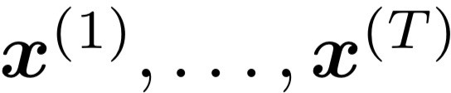





Training an RNN Language Model
Get a big corpus of text which is a sequence of words
Feed into RNN-LM; compute output distribution
for every step t.
i.e., predict probability dist of every word, given words so far
Loss function on step t is cross-entropy between predicted probability distribution , and the true next word (one-hot for ):
Average this to get overall loss for entire training set:

Slide 36
















Training an RNN Language Model
= negative log prob of “students”
= negative log prob of “opened”
= negative log prob of “their”
= negative log prob of “exams”
Loss
Predicted prob dists
+ … =
…
Corpus
the
students
opened
their
exams
…

Slide 37


Training an RNN Language Model
However: Computing loss and gradients across entire corpus too expensive (memory-wise)!
at once is
In practice, consider as a sentence (or a document)
Recall: Stochastic Gradient Descent(SGD) allows us to compute loss and gradients for small chunk of data, and update.
Compute loss for a sentence (actually, a batch of sentences), compute gradients and update weights. Repeat on a new batch of sentences.

Slide 38



Multivariable Chain Rule
Source:
https://www.khanacademy.org/math/multivariable-calculus/multivariable-derivatives/differentiating-vector-valued-functions/a/multivariable-chain-rule-simple-version

Slide 39











Training the parameters of RNNs: Backpropagation for RNNs
In practice, often “truncated” after ~20 timesteps for training efficiency reasons
…
…
equals
equals
equals
equals
equals
Apply the multivariable chain rule:
= 1
Question: How do we calculate this?
Answer: Backpropagate over timesteps
i = t, … ,0, summing gradients as you go. This algorithm is called “backpropagation through time” [Werbos, P.G., 1988, Neural Networks 1, and others]

Slide 40

Generating with an RNN Language Model (“Generating roll outs”)
Just like an n-gram Language Model, you can use a RNN Language Model to generate text by repeated sampling. Sampled output becomes next step’s input.
my
sample
favorite
sample
season
sample
is
sample
spring
sample
</s>
sample
<s>
my favorite
season
is
spring

Slide 41


Generating text with an RNN Language Model
Let’s have some fun!
You can train an RNN-LM on any kind of text, then generate text in that style.
RNN-LM trained on Obama speeches:
Source: https://medium.com/@samim/obama-rnn-machine-generated-political-speeches-c8abd18a2ea0

Slide 42









Problems with RNNs: Vanishing and Exploding Gradients
?
chain rule!
chain rule!
chain rule!
Vanishing gradient problem: When these are small, the gradient signal gets smaller and smaller as it backpropagates further
What happens if these are small?

Slide 43


















Vanishing gradient proof sketch
Recall:
What if were the identity function, ?
(chain rule)
Consider the gradient of the loss on step , with respect to the hidden state on some previous step . Let
(chain rule)
(value of )
If W_{h} is “small”, then this term gets exponentially problematic as becomes large
Source: “On the difficulty of training recurrent neural networks”, Pascanu et al, 2013. http://proceedings.mlr.press/v28/pascanu13.pdf
(and supplemental materials), at http://proceedings.mlr.press/v28/pascanu13-supp.pdf

Slide 44









Vanishing gradient proof sketch
sufficient but
What’s wrong with ?
not necessary
Consider if the eigenvalues of are all less than 1:
(eigenvectors) using the eigenvectors of
We can write
as a basis:
Approaches 0 as
grows, so gradient vanishes
What about nonlinear activations (i.e., what we use?)
Pretty much the same thing, except the proof requires
for some
dependent on dimensionality and
Source: “On the difficulty of training recurrent neural networks”, Pascanu et al, 2013. http://proceedings.mlr.press/v28/pascanu13.pdf
(and supplemental materials), at http://proceedings.mlr.press/v28/pascanu13-supp.pdf

Slide 45
Why is vanishing gradient a problem?
Gradient signal from far away is lost because it’s much smaller than gradient signal from close-by.
So, model weights are updated only with respect to near effects, not long-term effects.

Slide 46
Effect of vanishing gradient on RNN-LM
LM task: When she tried to print her tickets, she found that the printer was out of toner. She went to the stationery store to buy more toner. It was very overpriced. After installing the toner into the printer, she finally printed her
To learn from this training example, the RNN-LM needs to model the dependency between “tickets” on the 7th step and the target word “tickets” at the end.
But if the gradient is small, the model can’t learn this dependency
So, the model is unable to predict similar long-distance dependencies at test time

Slide 47

Why is exploding gradient a problem?
If the gradient becomes too big, then the SGD update step becomes too big:
learning rate
gradient
This can cause bad updates: we take too large a step and reach a weird and bad parameter configuration (with large loss)
You think you’ve found a hill to climb, but suddenly you’re in Iowa
In the worst case, this will result in Inf or NaN in your network (then you have to restart training from an earlier checkpoint)

Slide 48

Gradient clipping: solution for exploding gradient
Gradient clipping: if the norm of the gradient is greater than some threshold, scale it down before applying SGD update
Intuition: take a step in the same direction, but a smaller step
In practice, remembering to clip gradients is important, but exploding gradients are an easy problem to solve
Source: “On the difficulty of training recurrent neural networks”, Pascanu et al, 2013. http://proceedings.mlr.press/v28/pascanu13.pdf

Slide 49

How to fix the vanishing gradient problem?
The main problem is that it’s too difficult for the RNN to learn to preserve information over many timesteps.
In a vanilla RNN, the hidden state is constantly being rewritten
First off next time: How about an RNN with separate memory which is added to?
LSTMs
And then: Creating more direct and linear pass-through connections in model
Attention, residual connections, etc.

Slide 50

Long Short-Term Memory RNNs (LSTMs)
A type of RNN proposed by Hochreiter and Schmidhuber in 1997 as a solution to the problem of vanishing gradients
Everyone cites that paper but really a crucial part of the modern LSTM is from Gers et al. (2000) 💜
Only started to be recognized as promising through the work of S’s student Alex Graves c. 2006
Work in which he also invented CTC (connectionist temporal classification) for speech recognition
Became really well-known after Hinton brought it to Google in 2013
Following Graves having been a postdoc with Hinton
Hochreiter and Schmidhuber, 1997. Long short-term memory. https://www.bioinf.jku.at/publications/older/2604.pdf Gers, Schmidhuber, and Cummins, 2000. Learning to Forget: Continual Prediction with LSTM. https://dl.acm.org/doi/10.1162/089976600300015015
Graves, Fernandez, Gomez, and Schmidhuber, 2006. Connectionist temporal classification: Labelling unsegmented sequence data with recurrent neural nets.
https://www.cs.toronto.edu/~graves/icml_2006.pdf

Slide 51
Long Short-Term Memory RNNs (LSTMs)
On step t, there is a hidden state 𝒉^{(𝑡)} and a cell state 𝒄^{(𝑡)}
Both are vectors length n
The cell stores long-term information
The LSTM can read, erase, and write information from the cell
The cell becomes conceptually rather like RAM in a computer
The selection of which information is erased/written/read is controlled by three corresponding gates (gates are calculated things whose values are probabilities)
The gates are also vectors of length n
On each timestep, each element of the gates can be open (1), closed (0), or somewhere in-between
The gates are dynamic: their value is computed based on the current context

Slide 52


Long Short-Term Memory(LSTMs)
We have a sequence of inputs 𝑥^{(𝑡)}, and we will compute a sequence of hidden states ℎ^{(𝑡)} and cell states
𝑐^{(𝑡)}. On timestep t:
Sigmoid function: all gate values are between 0 and 1
Forget gate: controls what is kept vs forgotten, from previous cell state
Input gate: controls what parts of the new cell content are written to cell
All these are vectors of same length n
Output gate: controls what parts of cell are output to hidden state
New cell content: this is the new content to be written to the cell
Cell state: erase (“forget”) some content from last cell state, and write (“input”) some new cell content
⊙
⊙
⊙
Hidden state: read (“output”) some content from the cell
Gates are applied using element-wise (or Hadamard) product: ⊙

Slide 53


Long Short-Term Memory (LSTMs)
You can think of the LSTM equations visually like this:
Source: http://colah.github.io/posts/2015-08-Understanding-LSTMs/

Slide 54

Long Short-Term Memory (LSTMs)
𝑦$_{𝑡}
You can think of the LSTM equations visually like this:
Write some new cell content
The + sign is the secret!
Forget some cell content
ct-1
c_{t}
c
t
f
i_{t}
~_{c}
o_{t}
Output some cell content to the hidden state
Compute the forget gate
t
t
ht-1
h_{t}
Compute the input gate
Compute the new cell content
Compute the output gate
Source: http://colah.github.io/posts/2015-08-Understanding-LSTMs/

Slide 55
How does LSTM solve vanishing gradients?
The LSTM architecture makes it much easier for an RNN to preserve information over many timesteps
e.g., if the forget gate is set to 1 for a cell dimension and the input gate set to 0, then the information of that cell is preserved indefinitely.
In contrast, it’s harder for a vanilla RNN to learn a recurrent weight matrix W_{h} that preserves info in the hidden state
In practice, you get about 100 timesteps rather than about 7
However, there are alternative ways of creating more direct and linear pass-through connections in models for long distance dependencies

Slide 56




Gated Recurrent Units (GRU)
Proposed by Cho et al. in 2014 as a simpler alternative to the LSTM.
On each timestep t we have input and hidden state (no cell state).
Update gate: controls what parts of hidden state are updated vs preserved
Reset gate: controls what parts of previous hidden state are used to compute new content
New hidden state content: reset gate selects useful parts of prev hidden state. Use this and current input to compute new hidden content.
Hidden state: update gate simultaneously controls what is kept from previous hidden state, and what is updated to new hidden state content
How does this solve vanishing gradient? Like LSTM, GRU makes it easier to retain info long-term (e.g. by setting update gate to 0)
"Learning Phrase Representations using RNN Encoder–Decoder for Statistical Machine Translation", Cho et al. 2014, https://arxiv.org/pdf/1406.1078v3.pdf

Slide 57
LSTM vs GRU
Researchers have proposed many gated RNN variants, but LSTM and GRU are the most widely-used
The biggest difference is that GRU is quicker to compute and has fewer parameters
There is no conclusive evidence that one consistently performs better than the other
LSTM is a good default choice (especially if your data has particularly long dependencies, or you have lots of training data)
Rule of thumb: start with LSTM, but switch to GRU if you want something more efficient

Slide 58
Is vanishing/exploding gradient just a RNN problem?
No! It can be a problem for all neural architectures (including feed-forward and convolutional), especially deep ones.
Due to chain rule / choice of nonlinearity function, gradient can become vanishingly small as it backpropagates
Thus lower layers are learnt very slowly (hard to train)
Solution: lots of new deep feedforward/convolutional architectures that
add more direct connections (thus allowing the gradient to flow)
Conclusion: Though vanishing/exploding gradients are a general problem, RNNs are particularly unstable due to the repeated multiplication by the same weight matrix [Bengio et al, 1994]
”Learning Long-Term Dependencies with Gradient Descent is Difficult", Bengio et al. 1994, http://ai.dinfo.unifi.it/paolo//ps/tnn-94-gradient.pdf

Slide 59



RNNs can be used as a sentence encoder model
e.g., for sentiment classification
positive
How to compute
sentence encoding?
Basic way:
Use final hidden state
Usually better: Take element-wise max or mean of all hidden states
Sentence encoding
equals
overall
I
enjoyed
the
movie
a
lot

Slide 60

Bidirectional and Multi-layer RNNs: motivation
Task: Sentiment Classification
positive
We can regard this hidden state as a representation of the word “terribly” in the context of this sentence. We call this a contextual representation.
Sentence encoding
These contextual representations only contain information about the left context (e.g. “the movie was”).
What about right
context?
In this example, “exciting” is in the right context and this modifies the meaning of “terribly” (from negative to positive)
element-wise mean/max
element-wise mean/max
the
movie was
terribly
exciting
!

Slide 61

Bidirectional RNNs
This contextual representation of “terribly” has both left and right context!
Concatenated hidden states
Backward RNN
Forward RNN
the
movie
was terribly
exciting
!

Slide 62

Bidirectional RNNs
This is a general notation to mean “compute one forward step of the RNN” – it could be a simple RNN or LSTM computation.
On timestep t:
Forward RNN
Backward RNN Concatenated hidden states
Generally, these two RNNs have separate weights
We regard this as “the hidden state” of a bidirectional RNN. This is what we pass on to the next parts of the network.

Slide 63

Bidirectional RNNs: simplified diagram
the
movie was
terribly
exciting
!
The two-way arrows indicate bidirectionality and the depicted hidden states are assumed to be the concatenated forwards+backwards states

Slide 64
Bidirectional RNNs
Note: bidirectional RNNs are only applicable if you have access to the entire input sequence
They are not applicable to Language Modeling, because in LM you only have left context available.
If you do have entire input sequence (e.g., any kind of encoding), bidirectionality is powerful (you should use it by default).
For example, BERT (Bidirectional Encoder Representations from Transformers) is a powerful pretrained contextual representation system built on bidirectionality.

Slide 65






Multi-layer RNNs
RNNs are already “deep” on one dimension (they unroll over many timesteps)
We can also make them “deep” in another dimension by applying multiple RNNs – this is a multi-layer RNN.
This allows the network to compute more complex representations
The lower RNNs should compute lower-level features and the higher RNNs should compute higher-level features.
Multi-layer RNNs are also called stacked RNNs.

Slide 66

Multi-layer RNNs
The hidden states from RNN layer i
are the inputs to RNN layer i+1
RNN layer 3
RNN layer 2
RNN layer 1
the
movie
was terribly
exciting
!

Slide 67
Machine Translation
Machine Translation (MT) is the task of translating a sentence x from one language (the source language) to a sentence y in another language (the target language).
x:
L'homme est né libre, et partout il est dans les fers
y:
Man is born free, but everywhere he is in chains
– Rousseau

Slide 68


1990s-2010s: Statistical Machine Translation
Core idea: Learn a probabilistic model from data
Suppose we’re translating French → English.
We want to find best English sentence y, given French sentence x
Use Bayes Rule to break this down into two components to be learned separately:
Translation Model
Models how words and phrases should be translated (fidelity).
Learned from parallel data.
Language Model
Models how to write good English (fluency).
Learned from monolingual data.

Slide 69

What happens in translation isn’t trivial to model!
1519年600名西班牙人在墨西哥登陸，去征服幾百萬人口 的阿茲特克帝國，初次交鋒他們損失了三分之二的士兵。
In 1519, six hundred Spaniards landed in Mexico to conquer the Aztec Empire with a population of a few million. They lost two thirds of their soldiers in the first clash.
translate.google.com (2009): 1519 600 Spaniards landed in Mexico, millions of people to conquer the Aztec empire, the first two-thirds of soldiers against their loss. translate.google.com (2013): 1519 600 Spaniards landed in Mexico to conquer the Aztec
empire, hundreds of millions of people, the initial confrontation loss of soldiers two-thirds.
translate.google.com (2015): 1519 600 Spaniards landed in Mexico, millions of people to conquer the Aztec empire, the first two-thirds of the loss of soldiers they clash.

Slide 70
1990s–2010s: Statistical Machine Translation
SMT was a huge research field
The best systems were extremely complex
Hundreds of important details
Systems had many separately-designed subcomponents
Lots of feature engineering
Need to design features to capture particular language phenomena
Required compiling and maintaining extra resources
Like tables of equivalent phrases
Lots of human effort to maintain
Repeated effort for each language pair!

Slide 71

2014
Neural
Machine
Translation
MT research
(dramatic reenactment)

Slide 72
What is Neural Machine Translation?
Neural Machine Translation (NMT) is a way to do Machine Translation with a single end-to-end neural network
The neural network architecture is called a sequence-to-sequence model (aka seq2seq) and it involves two RNNs

Slide 73


Neural Machine Translation (NMT)
The sequence-to-sequence model
Target sentence (output)
Encoding of the source sentence.
Provides initial hidden state
for Decoder RNN.
he hit me with a pie <END>
argmax
argmax
argmax
argmax
argmax
argmax
argmax
Encoder RNN
Decoder RNN
il
m’
a entarté
<START> he hit me with a pie
Source sentence (input)
Decoder RNN is a Language Model that generates target sentence, conditioned on encoding.
Encoder RNN produces an encoding of the source sentence.
Note: This diagram shows test time behavior: decoder output is fed in as next step’s input

Slide 74
Sequence-to-sequence is versatile!
The general notion here is an encoder-decoder model
One neural network takes input and produces a neural representation
Another network produces output based on that neural representation
If the input and output are sequences, we call it a seq2seq model
Sequence-to-sequence is useful for more than just MT
Many NLP tasks can be phrased as sequence-to-sequence:
Summarization (long text → short text)
Dialogue (previous utterances → next utterance)
Parsing (input text → output parse as sequence)
Code generation (natural language → Python code)

Slide 75

Neural Machine Translation (NMT)
The sequence-to-sequence model is an example of a Conditional Language Model
Language Model because the decoder is predicting the next word of the target sentence y
Conditional because its predictions are also conditioned on the source sentence x
NMT directly calculates
:
Probability of next target word, given target words so far and source sentence x
Question: How to train an NMT system?
(Easy) Answer: Get a big parallel corpus…
But there is now exciting work on “unsupervised NMT”, data augmentation, etc.

Slide 76










Training a Neural Machine Translation system
= negative log prob of “he”
= negative log prob of “with”
= negative log prob of <END>
𝐽 = $\frac{1}{Τ}\sum_{t=1}^{Τ}{{\text{J}}_{t}}$
𝐽₁
$${\text{J}}_{3}$$
$${\text{J}}_{4}$$
$${\text{J}}_{7}$$
=
+
𝐽₂
+ +
+
$${\text{J}}_{5}$$
𝐽₆
+ +
𝑦"₁
𝑦"₂
𝑦“₃
${\text{y}\text{"}}_{4}$
$${\text{y}\text{"}}_{5}$$
𝑦"₆
${\text{y}\text{"}}_{7}$
Encoder RNN
Decoder RNN
il m’ a entarté
Source sentence (from corpus)
<START> he hit me with
Target sentence (from corpus)
a pie
Seq2seq is optimized as a single system. Backpropagation operates “end-to-end”.

Slide 77



Multi-layer deep encoder-decoder machine translation net
[Sutskever et al. 2014; Luong et al. 2015]
The hidden states from RNN layer i
are the inputs to RNN layer i+1
Translation generated
The protests escalated
over
the weekend <EOS>
0.1
0.3
0.1
-0.4
0.2
0.2
0.6
-0.1
-0.7
0.1
0.4
0.4
0.3
-0.2
-0.3
0.5
0.5
0.9
-0.3
-0.2
0.2
0.6
-0.1
-0.5
0.1
-0.1
0.6
-0.1
-0.7
0.1
0.2
0.6
-0.1
-0.7
0.1
0.2
0.6
-0.1
-0.7
0.1
0.3
0.6
-0.1
-0.7
0.1
0.4
0.4
-0.1
-0.7
0.1
-0.2
0.6
-0.1
-0.7
0.1
-0.4
0.6
-0.1
-0.7
0.1
-0.3
0.5
-0.1
-0.7
0.1
Encoder: Builds up sentence meaning
0.2
-0.2
-0.1
0.1
0.1
0.2
0.6
-0.1
-0.7
0.1
0.1
0.3
-0.1
-0.7
0.1
0.2
0.6
-0.1
-0.4
0.1
0.2
-0.8
-0.1
-0.5
0.1
0.2
0.6
-0.1
-0.7
0.1
0.2
-0.1
-0.1
-0.7
0.1
-0.4
0.6
-0.1
-0.7
0.1
0.2
0.6
-0.1
0.3
0.1
-0.1
0.6
-0.1
0.3
0.1
0.2
0.4
-0.1
0.2
0.1
0.3
0.6
-0.1
-0.5
0.1
0.2
0.6
-0.1
-0.7
0.1
Decoder
0.2
0.6
-0.1
-0.7
0.1
0.4
-0.6
0.2
-0.3
0.4
0.2
-0.3
-0.1
-0.4
0.2
0.2
0.4
0.1
-0.5
-0.2
0.4
-0.2
-0.3
-0.4
-0.2
0.2
0.6
-0.1
-0.7
0.1
0.2
0.6
-0.1
-0.7
0.1
0.2
0.6
-0.1
-0.7
0.1
0.2
0.6
-0.1
-0.7
0.1
-0.1
0.3
-0.1
-0.7
0.1
-0.2
0.6
0.1
0.3
0.1
-0.4
0.5
-0.5
0.4
0.1
0.2
0.6
-0.1
-0.7
0.1
Source sentence
Die Proteste
waren
am Wochenende eskaliert <EOS>
The protests
escalated
over
the weekend
Feeding in last word
Condition=Bottleneck

Slide 78






Attention mechanisms
𝑦"₁
𝑦"₂
𝑦“₃
${\text{y}\text{"}}_{4}$
${\text{y}\text{"}}_{5}$
𝑦"₆
${\text{y}\text{"}}_{7}$
Encoder
Decoder
il m’ a entarté
Source sentence (from corpus)
<START> he hit me with
Target sentence (from corpus)
a pie
C
$${\text{y}\text{"}}_{1}=f(c)$$
$${\text{y}\text{"}}_{2}=f(c ,{ \text{y}\text{"}}_{1})$$
$${\text{y}\text{"}}_{3}=f(c ,{ \text{y}\text{"}}_{1},{ \text{y}\text{"}}_{2})$$
…
Each word in Source sentence have the same weight for any ${\text{y}\text{"}}_{i}$

Slide 79










Attention mechanisms
$$f({ C}_{3})$$
$$f({ C}_{2})$$
$$f({ C}_{1})$$
S$oftmaxs$
𝑦"₁
𝑦"₂
𝑦“₃
${\text{y}\text{"}}_{4}$
${\text{y}\text{"}}_{5}$
𝑦"₆
${\text{y}\text{"}}_{7}$
Encoder
Decoder
il m’ a entarté
Source sentence (from corpus)
<START> he hit me with
Target sentence (from corpus)
a pie
$${\text{y}\text{"}}_{1}=f({ C}_{1})$$
$${\text{y}\text{"}}_{2}=f({ C}_{2},{ \text{y}\text{"}}_{1})$$
$${\text{y}\text{"}}_{3}=f({ C}_{3} ,{ \text{y}\text{"}}_{1},{ \text{y}\text{"}}_{2})$$
…

Slide 80

Attention mechanisms

Slide 81








NMT: the first big success story of NLP Deep Learning
Neural Machine Translation went from a fringe research attempt in 2014 to the leading standard method in 2016
2014: First seq2seq paper published [Sutskever et al. 2014]
2016: Google Translate switches from SMT to NMT – and by 2018 everyone had
https://www.nytimes.com/2016/12/14/magazine/the-great-ai-awakening.html
This was amazing!
SMT systems, built by hundreds of engineers over many years, were outperformed by NMT systems trained by small groups of engineers in a few months

Slide 82
References
CNN : @ Hung-Yi Lee machine learning 2021 spring
Language model @ Stanford /Spring 2021 CS224n: Natural Language Processing with Deep Learning
RNN :@ Stanford /Spring 2021 CS224n: Natural Language Processing with Deep Learning
Vanishing and Exploding Gradients: @ Stanford /Spring 2021 CS224n: Natural Language Processing with Deep Learning
LSTM: @ Stanford /Spring 2019 CS224n: Natural Language Processing with Deep Learning
GRU: @ Stanford /Spring 2019 CS224n: Natural Language Processing with Deep Learning
Seq2seq: @ Stanford /Spring 2021 CS224n: Natural Language Processing with Deep Learning
Attention mechanisms: @attention机制及self-attention(transformer)

